Slide 2
Chapter 6
Assessing Policy Alternatives

Slide 3
Introduction
How do policy makers use criteria to evaluate the alternatives?
Which evaluative criteria are typically used?
What methods do policy analysts use to research the likely impacts of alternatives?

Slide 4
Review: Steps in the Policy Analysis Process
Define and analyze the problem
Construct policy alternatives
Develop evaluative criteria
Assess policy alternatives
Draw conclusions

Slide 5
Develop Evaluative Criteria
How should we choose the proper policy action(s)?
On what basis should we make our choice?
What is an alternative likely to cost?
Will the proposal be politically feasible?

Slide 6
Obama’s Fuel Efficiency Policies
What policies should be put in place to increase efficiency of vehicles?
Notes:
What policies should be put in place to increase efficiency of vehicles? See introduction part of Chapter 6.

Slide 7
How Do Policy Makers Use Criteria to Select Policies?
Choosing the Appropriate Policy Alternative

Slide 8
How Do You Make an Important Decision?
Car to purchase
College to attend
Recipient of award

Slide 9
Evaluative Criteria
Standards on which you will make comparisons
Key aspects or factors to examine
Apply the same criteria for a given policy problem for which alternatives are proposed
Several criteria are commonly used for every decision

Slide 10
Why Are Criteria Used?
Policy decisions are complicated
  Criteria focus you on what’s important
  Criteria organize your thinking
Using criteria leads to better decisions
For a given decision:
  . . .“determine which criteria are most important and then rank policy alternatives from best to worst.” (Kraft/Furlong, 2015)

Slide 11
Which Evaluative Criteria Are Typically Used?
Effectiveness, efficiency

Slide 12
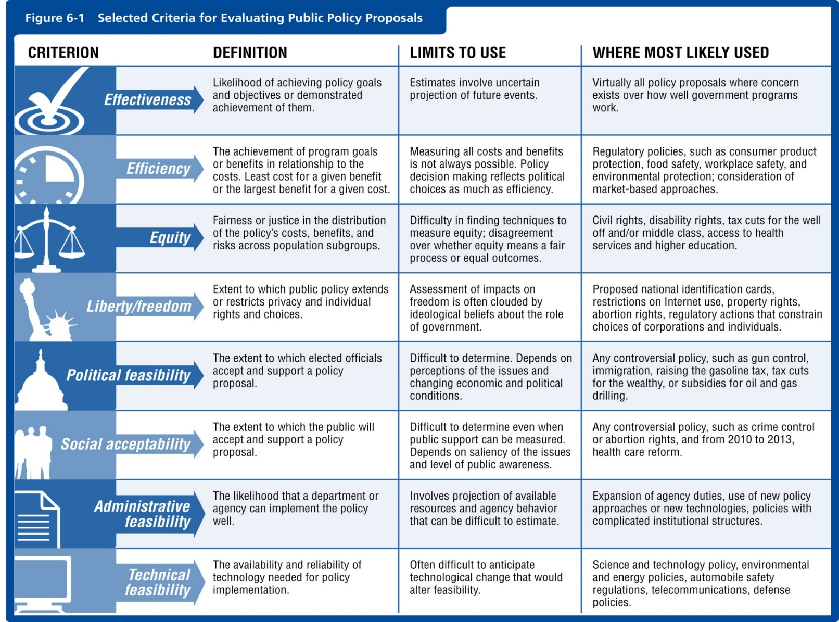
Notes:
Figure 6-1

Slide 13
Using Evaluative Criteria
Different decisions have different criteria
  The criteria should relate well to the decision
  The situation/context influences choice of criteria
Decision criteria should be operational measures or indicators
  Objective and measurable
  Example:
    Policy to improve highway safety
    Operational measure: automobile accident rates

Slide 14
Evaluative Criteria: Effectiveness
Did the policy work!?
Does the policy alternative reach its outcome goals?
  Operational measures that define “effective”
  An estimate of its likelihood of working
What does effective foreign policy look like?
Podcast: http://www.wnyc.org/story/obamas-lasting-foreign-policy-legacy/
President Obama’s Lasting Foreign Policy Legacy (WNYC). January 27, 2017. How should President Obama’s foreign policy be judged? Has it been effective? What measures should be used to assess its effectiveness? Troop deployment? Peace? (Time: 8:00)
Notes:
Video: http://www.youtube.com/watch?v=46OLt8vsPFU “Has President Obama’s foreign policy been effective?” British Broadcast Company (BBC). May 27, 2014. How should President Obama’s foreign policy be judged? Has it been effective? What measures should be used to assess its effectiveness? Troop deployment? Peace? (Time: 2:30)

Slide 15
Evaluative Criteria: Efficiency
One step beyond effectiveness: Effectiveness relative to costs
Efficiency is highly valued in the United States
Efficient policy: Works well at a low cost
Smoking prevention. Clearly efficient.
  -Why haven’t we made smoking illegal?
  . . . we also use the “Liberty” criterion.

Slide 16
Evaluative Criteria: Equity
Fairness in the distribution of costs, benefits, and risks across the population
Important when redistributive policies are proposed
Process versus outcome equity
Equity of tax policy, video: http://www.cnn.com/video/data/2.0/video/bestoftv/2012/11/21/exp-erin-taxing-the-wealth-to-reduce-inequality-and-avert-fiscal-cliff.cnn.html
“Economist: Tax wealth, not income.” CNN Video. November 21, 2012. Discuss the issue of equity regarding tax policy. Would it be more equitable to tax someone’s wealth as opposed to their income? (Time: 3:23)
Notes:
Video: http://www.cnn.com/video/data/2.0/video/bestoftv/2012/11/21/exp-erin-taxing-the-wealth-to-reduce-inequality-and-avert-fiscal-cliff.cnn.html “Economist: Tax wealth, not income.” CNN Video. November 21, 2012. Discuss the issue of equity regarding tax policy. Would it be more equitable to tax someone’s wealth as opposed to their income? (Time: 3:23)

Slide 17
Evaluative Criteria
Political Feasibility
  Will politicians support the alternative?
Social Acceptability
  Will the public support a proposal?

Slide 18
Evaluative Criteria
Technical feasibility:
  Are the technologies available to implement the policy? Can it be done?
Administrative feasibility:
  Can it be implemented and
  managed well?
  Example: healthcare.gov

Slide 19
What Methods Are Used to Study the Alternatives?
Economics, Decision Analysis, Ethics

Slide 20
Economic Methods Used in Policy Analysis
Cost-benefit analysis
Cost-effectiveness analysis
Risk assessment

Slide 21
Cost-Benefit Analysis
Financial savings compared to costs
Estimate all costs of a policy alternative
Estimate all financial benefits (revenues or savings)
“For every dollar invested, we saved US$_”

Slide 22
Cost-Effectiveness Analysis
Same as cost/benefit; don’t monetize benefits
Cost effectiveness of options to reduce binge drinking:
  Cost/effects of public education campaign
  Cost/effects of regulating bars/taverns
  Cost/effects of funding treatment programs
Which option reduces binge drinking the most at the lowest cost?

Slide 23
Risk Assessment
Identify, estimate, and evaluate physical risk to citizens
  Risk evaluation
  Risk management
Helps to choose a policy alternative
Goal: Reduce risks to the environment, society
  Various policy options reduce risk at certain costs

Slide 24
Analyzing Impacts
Forecasting: projections of what might happen if we choose this alternative
  Often: economic projections
  How many jobs will be created?
Impact assessment: similar approach
  Environmental impact studies
  Predict consequences of adopting a policy
Notes:
Discuss policy implications of the population changes and forecasting social security.
Forecasting example: Social Security
Impact Assessment example: U.S. Population Changes

Slide 25
Political and Institutional Analysis of Policy Alternatives
Political feasibility analysis:
  Do policy makers support this alternative?
Implementation analysis:
  Study how policy was implemented, not outcomes
Program evaluation:
  Applied research to measure policy outcomes
  Growing field of work in public sector
Ethical analysis:
  Liberty, equity

Slide 26
Wrap-Up
Policy makers use criteria to assess each alternative: their impact, cost, feasibility
  Criteria must be measurable or operationalized
Use of criteria improves the information and thus improves policy decisions
The most often-used criteria are effectiveness and efficiency
A variety of analytical tools are used
  Economic analyses
  Decision analyses
  Ethical analyses

